Slide 1
PJM Study of Carbon Pricing & Potential Leakage Mitigation Mechanisms
April 28, 2020
Emanuel Bernabeu, Ph.D.
Director – Applied Innovation & Analytics

Slide 2
Agenda
1
Introduction
2
Emissions Leakage
3
Border Adjustment
4
Conclusion & Final Remarks

Slide 3
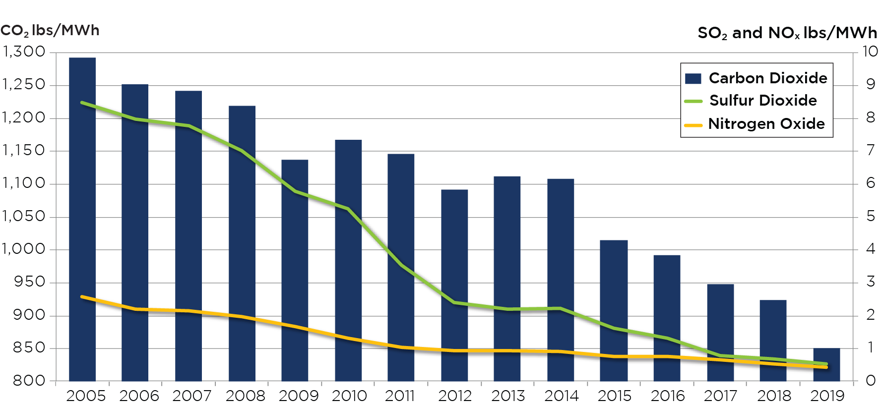
2005-2019 PJM Average Emission Rates
Notes:
Schuyler updated 2/04/2020

Slide 4
Introduction
Regional Approach
Sub-Regional Approach
Carbon-Pricing Region
Rest of RTO

Slide 5
Study on Carbon Pricing & Potential Leakage Mitigation
What It Is…
Information for Stakeholders.
Production-Cost Model
Border Adjustment: An Option for Leakage Mitigation.
Can coexist with RGGI.
What It Is NOT…
Macroeconomic
State Policy
PJM is NOT proposing a carbon price.
PJM is NOT proposing policy.

Slide 6
Emissions Leakage
Higher Carbon Price
Higher Net-RTO Emissions [0.5%, 1.7%]
Higher Carbon Price
Higher Emissions (Rest of RTO)
Carbon-Pricing Region
DE, MD, NJ
Higher Carbon Price
Lower Emissions (DE/MD/NJ)
$0
$7
$15
Carbon Price [$/ton]

Slide 7
Shift in Generation
Rest of RTO
Increase in Generation
(Primarily Coal)
Carbon-Pricing Region
Less Generation
(Primarily Gas)
-30,000
[GWhr]
+25,000
[GWhr]
GAS
COAL
@ $15/Ton of Carbon Price

Slide 8
Carbon Price Impact on LMP
Higher Carbon Price
Higher LMP (DE/MD/NJ)
Higher Carbon Price
Higher LMP (rest of RTO)
Impact on LMP is smaller for the rest of RTO.
Rest of RTO
Carbon-Pricing Region
$0
$7
$15
$0
$7
$15
Carbon Price [$/ton]
Carbon Price [$/ton]
Notes:
Impact on LMP is about double on sub-region than that on rest of RTO.
At max RGGI, $2 increase in carbon-pricing region and $1 in rest of RTO.

Slide 9
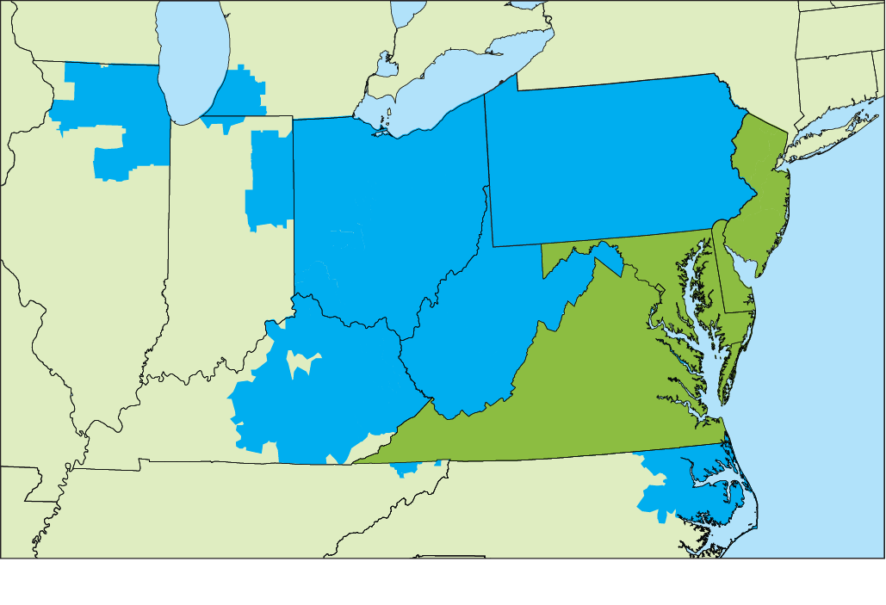
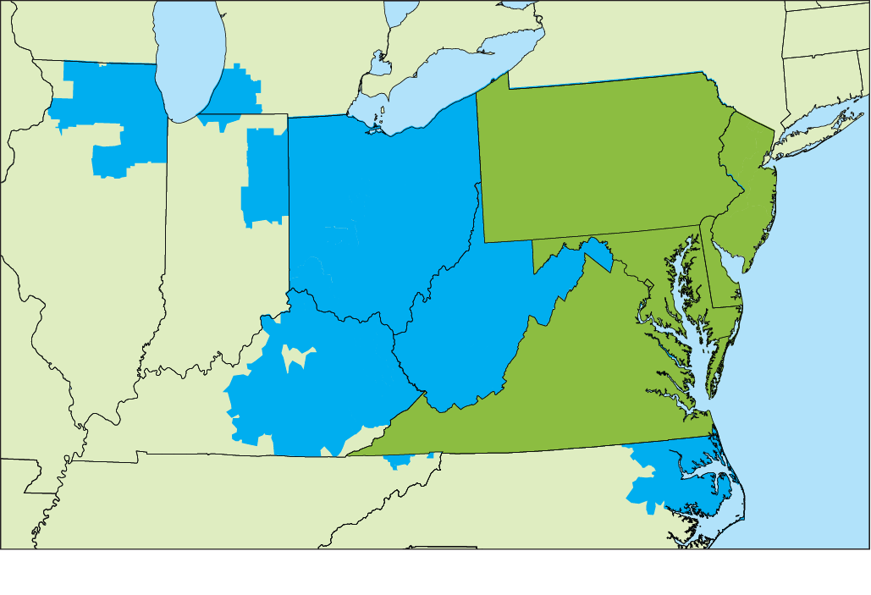
Leakage: A Function of Emission Intensities
Leakage is a function of generation mix and emissions intensities of each sub-region
$0
$7
$15
$0
$7
$15
$0
$7
$15
Carbon Price [$/ton]
Carbon Price [$/ton]
Carbon Price [$/ton]
DE, MD, NJ
DE MD NJ VA
DE MD NJ VA PA
Rest of RTO
Carbon-Pricing Region
90% RTO Generation
10% Less Export
80% RTO Generation
20% Less Export
60% RTO Generation
40% Less Export

Slide 10
Agenda
1
Introduction
2
Emissions Leakage
3
Border Adjustment
4
Conclusion & Final Remarks

Slide 11
Border Adjustment
No-Border Adjustment
1-Way Border Adjustment
2-Way Border Adjustment
Rest of RTO
CO2 Pricing Region
Rest of RTO
CO2 Pricing Region
Rest of RTO
CO2 Pricing Region
Offer
Offer with CO2 Price
Offer
Offer with CO2 Price
Offer
Offer
Offer with CO2 Price
Offer with CO2 Price
Offer with CO2 Price

Slide 12
Emissions With Border Adjustment
Lower Net-RTO emissions
Effectiveness of Border Adjustment depends on Carbon-Pricing Region
Increase Emissions in Carbon Pricing Region
DE, MD, NJ
DE MD NJ VA
DE MD NJ VA PA
90% RTO Generation
10% Less Export
Rest of RTO
Carbon-Pricing Region
80% RTO Generation
20% Less Export
60% RTO Generation
40% Less Export

Slide 13
Impact of LMP With Border Adjustment
Border Adjustment Lessens the Impact on LMP
DE, MD, NJ
DE MD NJ VA
DE MD NJ VA PA
Rest of RTO
Carbon-Pricing Region
90% RTO Generation
10% Less Export
80% RTO Generation
20% Less Export
60% RTO Generation
40% Less Export

Slide 14
Executive Summary Observations
Impacts of Carbon Pricing [$7, $15]:
Emissions leakage: at relatively low prices, emission leakage is in the order of [0.5%, 1.7%].
Higher LMP [4%,13%].
Border Adjustment tends to:
Lessens emissions leakage.
Lessens the impact on LMP (increase in uplift).
Increases emissions within the Carbon-Pricing region.
Next Steps:
Higher Carbon-Price [$25, $50]
RTO-wide Carbon Pricing.
NOT General Conclusions
(Do NOT extrapolate)
Strong function of:
States in the carbon region.
Generation mix and emissions intensity.
Carbon price (non-linear).
Notes:
Remember to mention that leakage was very small in the first place.
Weaker signal for generation within the sub-region

